Slide 1
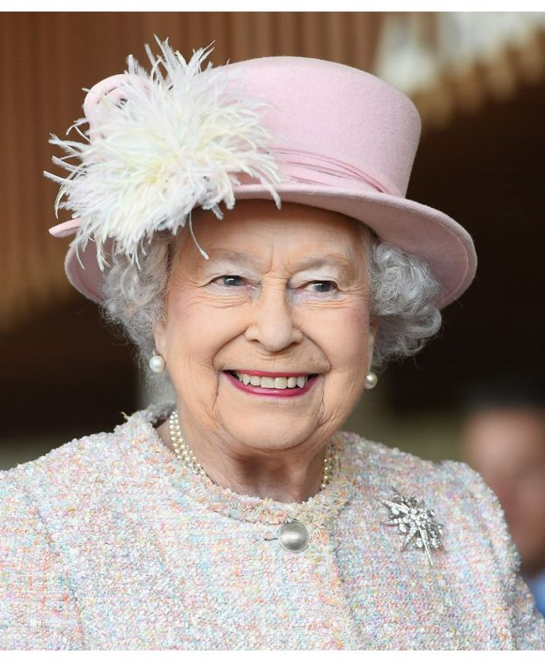
Death of Queen Elizabeth Tweet Analysis
Samma Behnami, Wendy Jiang, Somer Sinnard, Gwen Chaiyarat

Slide 2
Agenda
Project Objective
Question to consider
Data overview
Analysis
Takeaways
Limitations
Improvements

Slide 3
Project Objective
Capture the reactions to Queen Elizabeth II passing from tweets made right after her death
Compare sentiment metrics from Queen’s data with King Charles's data

Slide 4
Data Overview
The data came from Kaggle
Included raw tweets surrounding the immediate time-frame
- Keywords for corresponding tweet search was “Queen Elizabeth”
The dataset had approximately 59,000 rows and 32 columns
Use King Charles's data to do the comparison about public’s reaction

Slide 5
Data Preprocessing & Methods
Cleaned Mention and Reply_to nodes
Removed:
Non-English tweets
Whitespaces
Punctuation
English stop words
Emojis
Methods:
Python

Slide 6
Questions to Consider
What words were most frequently used?
What words are used together in a tweet most often?
What words are positively correlated?
In general, what were people’s attitudes towards her passing?
What part of speech made up the tweets?
What similar words occur?
What are the public's feelings toward the Queen’s death compared to King Charles' coronation?
What trends exist in the user interactions on the day of her death?
Who were the most influential users on the day of her death?

Slide 7
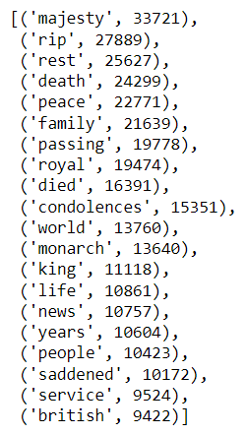
Q1: What words were most frequently used?
When analyzing the full list, we only saw positive words used
“Queen”, “Elizabeth” , and other variations were removed

Slide 8
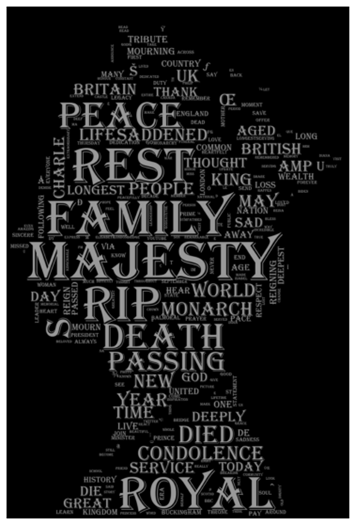
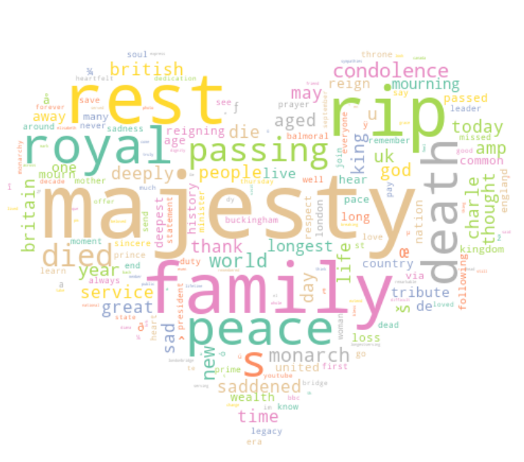
Word Clouds

Slide 9
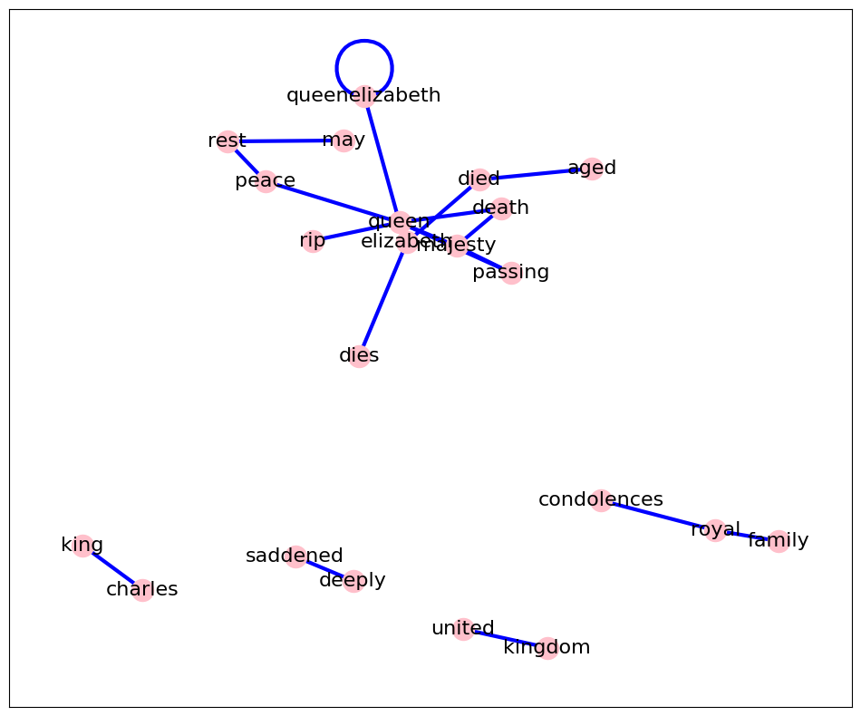
Q2: What words are used together in a tweet most often?
Notes:
The next question we wanted to answer was what words are used together in a tweet most often, we did this by creating a bigram list and then after that we created this network plot. The plot shows a lot of the same findings that we saw earlier, when people tweeted about queen Elizabeth. The words that were used in the same tweet were words associated with passing. We also saw other words that went together that made sense like king and Charles and royal and family

Slide 10
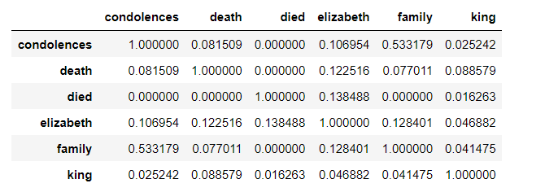
Q3: What words are positively correlated?
Notes:
The next question was what words are positively correlated with each other, and we found a lot of the same results as when we did the bigram, so this confirmed our findings and showed that there are not much variation in the overall tone.

Slide 11
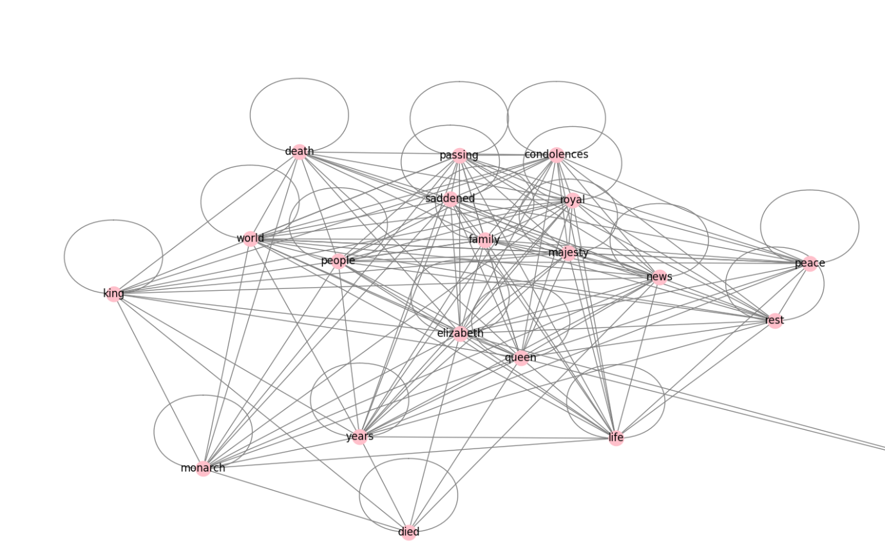
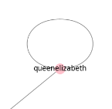
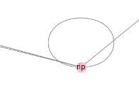
Network Plot
Notes:
We then created this visualization which again has relatively the same findings, people had nice things to say in her passing.

Slide 12
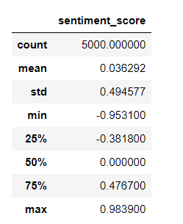
Q4: In general, what were people’s attitudes towards her passing?
Sentiment score assigned to a subset of a random 5,000 rows
Overall, a sentiment score with an average of 0.036 indicates people’s attitudes are relatively neutral
Notes:
We also wanted to find out generally what were people’s attitudes towards her passing and we thought the best way was to assign a sentiment score to the tweets but it was difficult to assign a score to all 60,000 tweets so we used a subset that randomized the tweets it scored and then we used descriptive statistics to look at the average, max, and min. overall the sentiment score had an average of 0.036 which indicated people’s attitudes are relatively neutral.

Slide 13
Q4: In general, what were people’s attitudes towards her passing?
Most positive tweet (0.9839 sentiment score):
“@MayorofLondon @yashar Thank you, Mayor Khan. I'm not in the UK, but still had great affection and respect for Queen Elizabeth II. She will be missed by me for sure. God grant all of you comfort for this is truly an end of an Era. “
Most negative tweet (-0.953100 sentiment score):
“Any U.S. citizen who's mourning Queen Elizabeth II's death is a loser. You live in a country whose national myth is premised on waging violent revolution against a monarchy &amp; you're mourning the death of a monarchy from that monarchy. Loser.”
But some are not as bad as others with a low score…. (-0.946800 sentiment score)
“Ngl I feel a little bad for meming on the queen's death. Death is really not something to meme about and it can be really disgusting behavior. A lot of people are guilty of meming on her death, and I am too. RIP Queen Elizabeth II.”
Notes:
Out of curiosity, we then looked at the highest sentiment score tweet and lowest sentiment score tweet and got these results

Slide 14
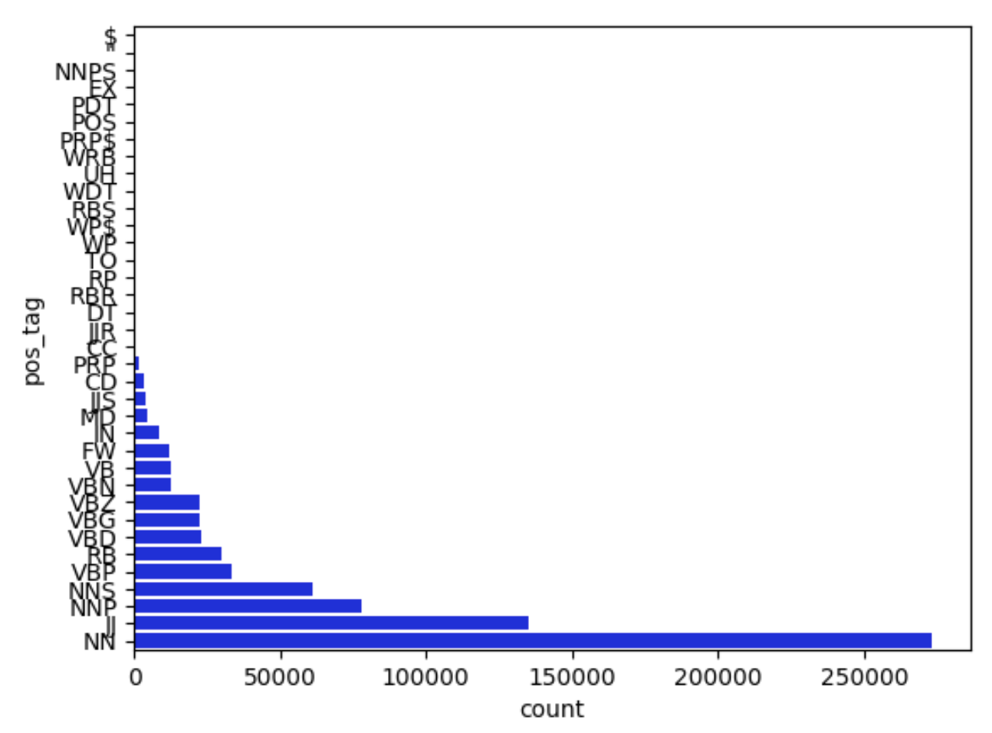
Q5: What part-of-speech made up the tweets?
POS_tag | Count
NN | 272936
JJ | 135023
NNP | 77750
NNS | 61359
VBP | 33136
RB | 29771
VBD | 23207
VBG | 22678
VBZ | 22177
Notes:
We want to further investigate the tweet by looking into the part of speech. Our findings are shown here. Singular noun has the highest count it make sense since the conversations are surrounding teh Queen and the following
POS_tag Count
NN 272936 noun/ singular
JJ 135023 Adjective
NNP 77750 Proper noun
NNS 61359 Noun/ Pural
VBP 33136 Present Verb
RB 29771 Adverb
VBD 23207 Verb Past tense
VBG 22678 Verb Present tense
VBZ 22177 Verb non- 3rd, singular present

Slide 15
Q6: What similar words occur?
text.similar('Queen’)
Administration, man, day, west, family, period, act, state, child, program, year, party, time, house, word, church, week, people, group, president
text.similar(‘King’)
Time, president, man, house, world, other, state, day, city, department, problem, future, work, church, question, group, west, family, trial, situation
text.similar('Monarch’)
County, place, city, court, other, two, administration, result, legislature, state, program, money, will, fire, citizens, doctor, night, work, police, office
text.similar('palace’)
City, house, world, moment, state, office, man, church, bill, people, right, west, family, summer, room, area, ground, situation, job
Notes:
Comparing the conversation about each individual and places.

Slide 16
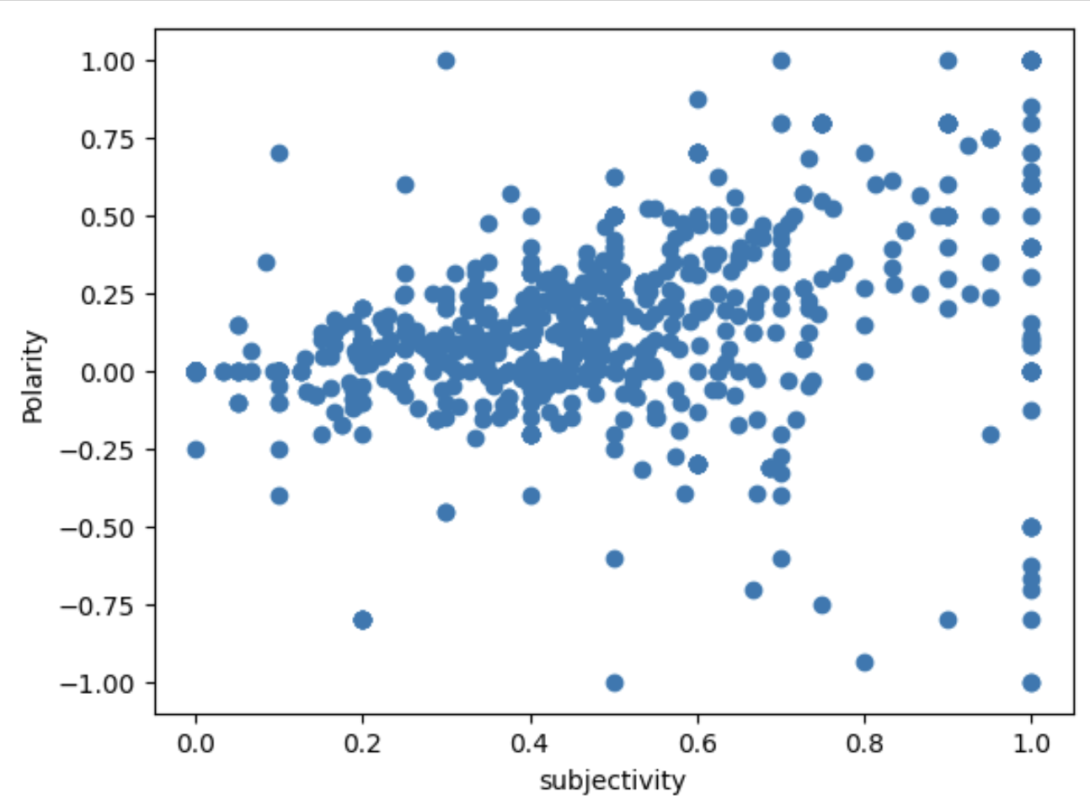
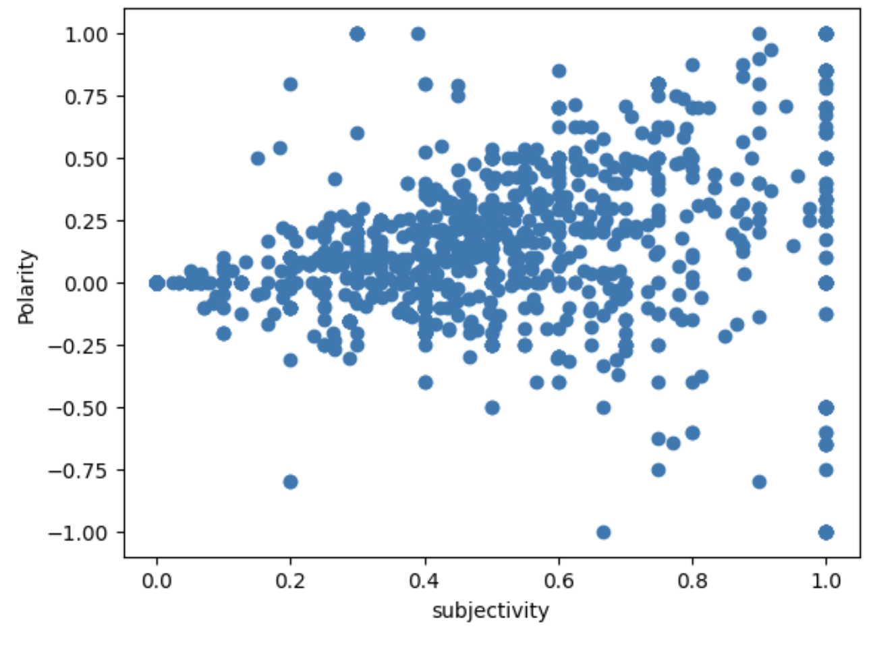
Q7: What are the public's feelings toward the Queen’s death compared to King Charles' coronation?
King’s data
Queen’s data
Notes:
Here’s the comparison of the datasets. We can see that the queen data has higher density but we determined that there’s no significant difference in trends

Slide 17
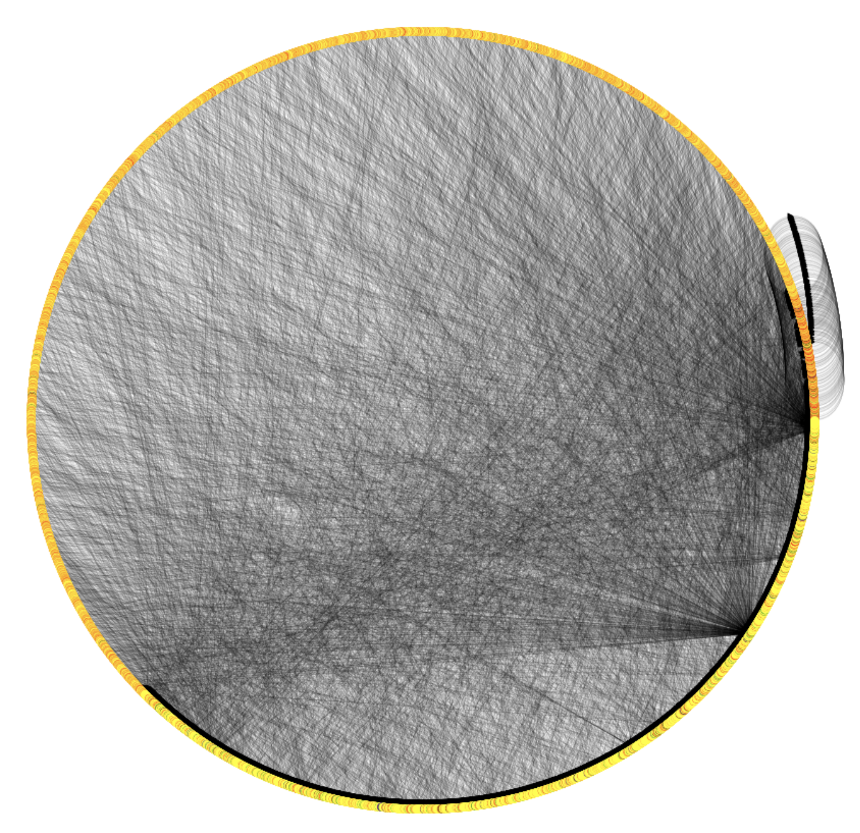
Q8: What trends exist in the user interactions on the day of her death?
Circular Layout
Directed network
Three points of high communication
Significant amount of self-mentions, darker cluster
Users with many likes not clustered
Users with low likes mentioning users with high likes
Likes Count Key
Blue: >10,000 likes
Green: 1,001 – 10,000 likes
Red: 101 – 1,000 likes
Orange: 1 – 100 likes
Yellow: 0 likes

Slide 18
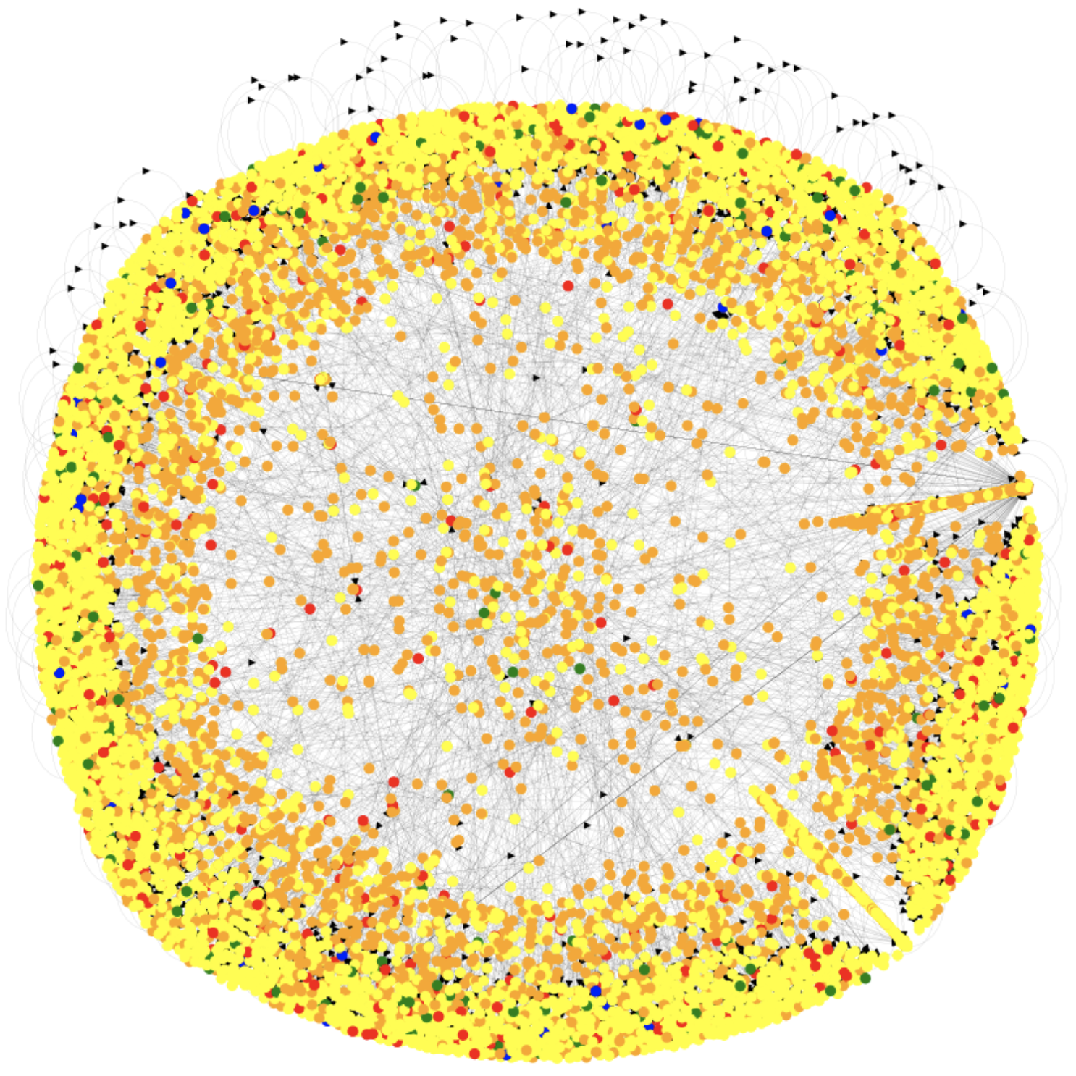
Q8: What trends exist in the user interactions on the day of her death?
Fruchterman-Reingold Layout
Directed network
Point of high communication
Close lines of low likes nodes, chain of mentions
Users receiving more likes relatively scattered
Likes Count Key
Blue: >10,000 likes
Green: 1,001 – 10,000 likes
Red: 101 – 1,000 likes
Orange: 1 – 100 likes
Yellow: 0 likes
Notes:
No blues driven toward the center
Yellows line the border with a layer of oranges falling in the next layer

Slide 19
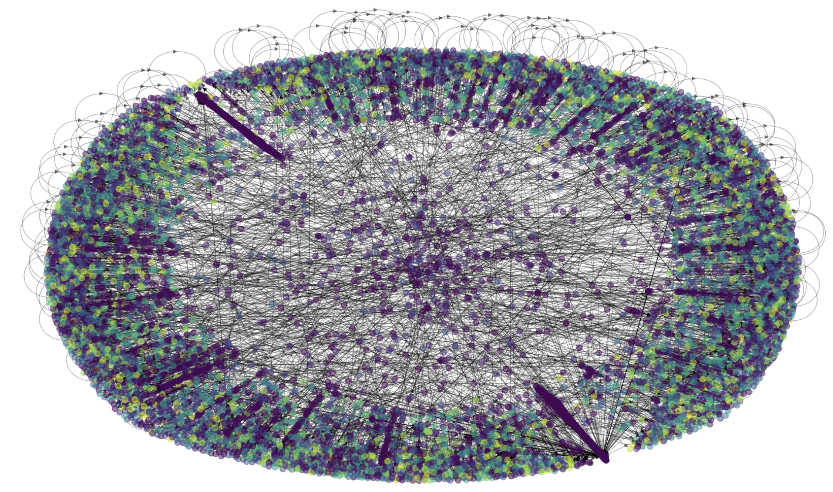
Q8: What trends exist in the user interactions on the day of her death?
Clauset-Newman-Moore Greedy Modularity Maximization
Community generation
Two points of high communication, chains of purple nodes extending to the center
Notes:
Dark purple and blue in the center

Slide 20

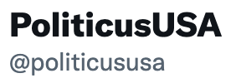
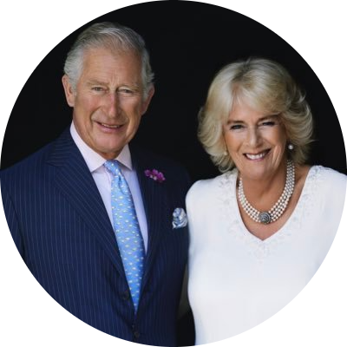
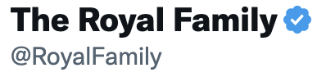

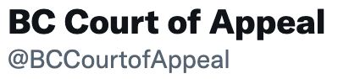

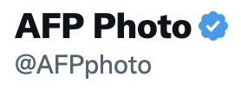
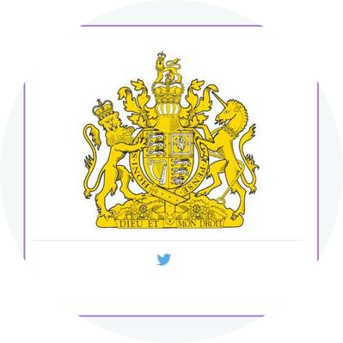
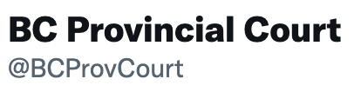

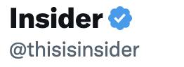

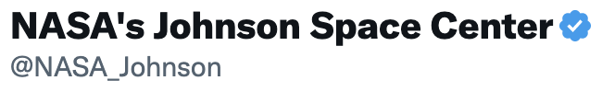

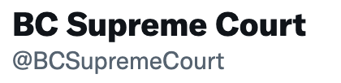
Q9: Who were the most influential users on the day of her death?
Notes on the network
Very low reciprocity: 0.00245 (average)
Extremely low density: 8.2257E-05 (average)
Node degree centrality fairly low across the board, but The Royal Family account had the highest value for all samples
Nodes with the highest Eigenvector Centralities
Sample 1:
Sample 2:
Sample 3:
Notes:
Averaged the metrics for the three samples
Low reciprocity: uncommon overall for a user to be mentioned in a tweet and mention the original user back in response
low density: very unconnected network of users, makes sense as this topic was a significant event globally
Eigenvector centrality:
- Ego’s influence is a function of Ego’s ties and Ego’s ties’ influence - Adjust a node’s prominence based on the relative prominence of the nodes to which it is tied
Sample threes most influential nodes are odd, must be a result of sampling and the three BC accounts having several records in the sample

Slide 21
Limitations
Missing overall user information data:
- follower count
- number of likes
- number of retweets
Edges and nodes had to be constructed from mentions data
Large dataset, time-consuming to run code, required sampling
Tweets captured only from the day of the Queen's death, not able to see how elements changed over time
Notes:
Viral-ness of tweets could skew results since just a snapshot from the day

Slide 22
Takeaways
In general, people had neutral attitudes towards her death
Variation in tweets but the meaning/message was relatively the same
Topic of new king wrapped in with discussion of her death

Slide 23
Improvements
Before beginning the project, we could have assigned polarity scores to see if there are enough people who tweeted negatively or positively to draw a conclusion

